Slide 1

Empowering Excellence Through Knowledge
Agile Project management
Workshop
Developed by:
IEM Consultancy Services

Slide 2
AGILE PROJECT MANAGEMENT
Agile Project Management (APM) is an iterative, collaborative, and flexible approach to managing projects, particularly in software development. It focuses on delivering value quickly, adapting to changes, and ensuring continuous customer feedback.
Agile Project Management is a modern, adaptive, and value-driven approach that enhances team collaboration, flexibility, and speed. It is widely used across industries to ensure efficient project execution and continuous improvement.

Slide 3
AGILE PROJECT MANAGEMENT
When to Use Agile?
✔ Software Development (e.g., apps, websites, AI solutions)
✔ Startups & Innovation Projects (fast-changing requirements)
✔ Complex & Uncertain Projects (where flexibility is key)
✔ Customer-Centric Workflows (frequent feedback required)
🚫 Not Ideal For:
❌ Fixed-scope, highly regulated industries (e.g., construction, healthcare compliance).
Benefits of Agile
Faster Delivery – Delivers value in small increments.
Flexibility – Adapts to changes quickly.
Higher Quality – Frequent testing and feedback.
Customer Satisfaction – Continuous involvement and quick adjustments.
Better Risk Management – Issues are identified early.
Feature | Agile 🏃‍♂️ | Waterfall ⏳
Approach | Iterative & incremental | Linear & sequential
Flexibility | High (can adapt) | Low (fixed plan)
Customer Involvement | Continuous feedback | Mostly at the end
Risk Management | Early detection & mitigation | Risks found late
Delivery | Frequent releases | One final delivery

Slide 4
AGILE PROJECT MANAGEMENT
Popular Agile Frameworks:
Scrum – Uses Sprints, Scrum Master, Product Owner, and development team.
Kanban – Uses a visual board to manage work-in-progress (WIP).
Lean – Focuses on reducing waste and maximizing value.
SAFe (Scaled Agile Framework) – Extends Agile for large enterprises.
Key Principles of Agile
Agile follows the 12 principles from the Agile Manifesto, but here are the four core values:
Individuals and interactions over processes and tools.
Working software over comprehensive documentation.
Customer collaboration over contract negotiation.
Responding to change over a plan.

Slide 5
AGILE PROJECT MANAGEMENT
How Agile Project Management Works?
Iterative Development (Sprints)
  Work is broken into small, manageable cycles called Sprints (1-4 weeks).
  Teams develop, test, and deliver functional increments in each Sprint.
Continuous Feedback & Adaptation
  Regular meetings (Daily Stand-ups, Sprint Reviews) allow for quick adjustments.
  Customer and stakeholder feedback is incorporated frequently.
Self-Organizing Teams
  Teams are cross-functional (developers, testers, designers).
  Members take ownership and make collaborative decisions.
Prioritization & Backlog Management
  The Product Backlog contains all feature requests.
  Teams prioritize tasks based on business value.

Slide 6
SCRUM FRAMEWORK
Scrum is an Agile framework used for managing complex projects, especially in software development. It promotes collaboration, flexibility, and iterative progress to deliver high-quality products efficiently.

Slide 7
SCRUM FRAMEWORK
Key Principles of Scrum
Empirical Process Control – Decisions are based on observation, experience, and experimentation.
Transparency – All aspects of the process must be visible to everyone involved.
Inspection – Frequent reviews of progress help identify and address issues early.
Adaptation – Plans are adjusted based on feedback and changing requirements.

Slide 8
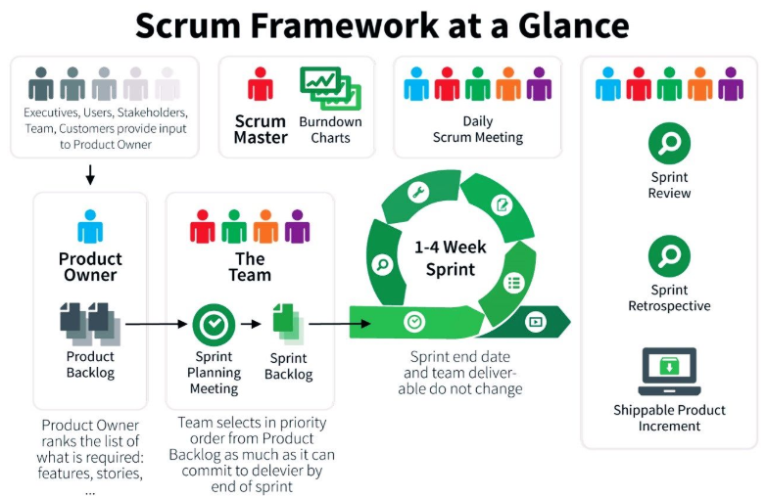

Slide 9
SCRUM ROLES
Product Owner
    Defines product vision and manages the product backlog.
    Prioritizes features based on business value.
    Represents customer interests.
Scrum Master
    Facilitates Scrum processes and ensures adherence to Agile principles.
    Removes roadblocks and fosters collaboration.
    Acts as a coach for the Scrum team.
Development Team
    Self-organizing, cross-functional team that builds and delivers the product.
    Works in sprints to develop and improve the product incrementally.

Slide 10
SCRUM WORKFLOW
Scrum Workflow (How Scrum Works?)
Product Owner creates & maintains the Product Backlog.
Sprint Planning – The team selects items from the backlog to work on.
Development Team works in Sprints – Daily Scrum meetings track progress.
Sprint Review – Work is demonstrated and feedback is gathered.
Sprint Retrospective – Team reflects on the sprint and improves processes.
Repeat for the next Sprint.

Slide 11
WHAT IS REFINEMENT IN SCRUM
In Scrum, Refinement (previously known as "Backlog Grooming") is the ongoing process of reviewing, clarifying, and improving the Product Backlog to ensure that it is ready for future Sprints.
This process helps the Scrum Team prioritize, estimate, and break down complex requirements into well-defined User Stories that can be completed within a Sprint.
How Does Refinement Work?
Who is Involved?
  Product Owner (PO) – Ensures backlog items align with business priorities.
  Development Team – Clarifies technical feasibility, dependencies, and effort.
  Scrum Master – Facilitates the process and ensures the backlog is well-structured.
When Does Refinement Happen?
  Ongoing Process – Refinement is not a Scrum Event but happens continuously.
  Backlog Refinement Meeting – Often held mid-Sprint (typically 1–2 sessions per Sprint).
What Happens During Refinement?
  ✔ Clarify Requirements – PO explains backlog items; team asks questions.
  ✔ Prioritize Items – High-value work is moved up in the backlog.
  ✔ Break Down Epics – Large Epics are split into smaller User Stories.
  ✔ Add Acceptance Criteria – Define what makes a story “done.”
  ✔ Estimate Story Points – The team assigns Fibonacci numbers for effort estimation.

Slide 12
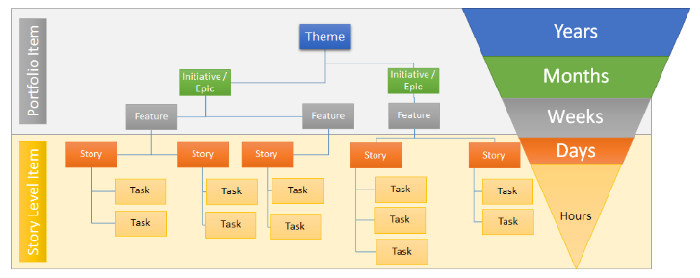
SCRUM EVENTS
(The Process of Scrum)
🚀 Why Use Themes in Agile?
✅ Aligns work with business goals 🎯
✅ Improves prioritization & focus 🔍
✅ Provides visibility to stakeholders 📊
✅ Helps in roadmap planning 🛤
1️⃣ Theme → A broad business objective (e.g., "Improve User Security").
2️⃣ Epic → A major feature related to the theme (e.g., "Implement User Authentication").
3️⃣ User Stories → Specific functionalities under the Epic (e.g., "User Login", "Password Reset").
4️⃣ Tasks → Individual development and testing efforts.

Slide 13
WHAT IS AN EPIC IN AGILE?
An Epic is a large user story in Agile project management that cannot be completed in a single iteration (Sprint). It represents a high-level requirement or feature that is later broken down into smaller, more manageable User Stories.
Think of it like a book:
Epic → A whole book (large functionality).
User Stories → Individual chapters (smaller tasks that contribute to the epic).
Key Characteristics of an Epic
High-Level Requirement – Represents a major feature or functionality.
Too Large for One Sprint – Needs to be broken into User Stories.
Flexible & Evolving – Can change based on feedback and priority.
Tied to Business Goals – Directly contributes to the product vision.
Example of an Epic
Epic: "Implement a User Authentication System"
User Stories within the Epic:
"As a user, I want to sign up using my email and password."
"As a user, I want to reset my password if I forget it."
"As an admin, I want to monitor login attempts for security."
Each User Story is small enough to be completed in a single Sprint, while the Epic represents the bigger picture.

Slide 14
SCRUM EVENTS
(The Process of Scrum)
Sprint (Time-boxed iteration)
  A fixed period (usually 2-4 weeks) where the team works on a Sprint Goal.
  At the end of the sprint, a working product increment is delivered.
Sprint Planning
  Held at the beginning of each sprint.
  Team selects backlog items and defines tasks.
Daily Scrum (Stand-up Meeting)
  A 15-minute meeting where the team discusses:
    What was done yesterday?
    What will be done today?
    Any blockers?
Sprint Review
  Held at the end of the sprint to showcase completed work.
  Stakeholders provide feedback.
Sprint Retrospective
  A session for the team to reflect on the sprint and identify improvements.
  Focuses on what went well, what went wrong, and what can be improved.

Slide 15
SCRUM ARTIFACTS (Key Components of Scrum)
Product Backlog
  A prioritized list of all features, enhancements, and fixes.
  Managed by the Product Owner.
Sprint Backlog
  A subset of the Product Backlog selected for a Sprint (typically 2–4 weeks).
  Created during Sprint Planning.
Increment
  The sum of all completed work that meets the Definition of Done (DoD)
  A potentially shippable product after each sprint.
Characteristics of an Increment
Must be usable – Even if not released, it should be functional.
Includes previous increments – Always builds on top of prior work.
Meets Definition of Done – Must satisfy quality standards before being considered complete.
Typical Checklist for DoD
✔ Code is written, reviewed, and merged
✔ Unit and integration tests passed
✔ No critical bugs remain
✔ Code is documented (if required)
✔ Feature is deployed in a staging/test environment
✔ User Acceptance Testing (UAT) is completed

Slide 16
SCRUM ARTIFACTS (Key Components of Scrum)
Why Definition of Done is Important?
💡 Without a strong DoD, teams risk:
❌ Delivering unfinished features
❌ Increasing technical debt
❌ Misalignment on what “done” means
❌ Releasing buggy, untested software
A clear and strict Definition of Done ensures high-quality Increments, leading to a successful Agile delivery.

Slide 17
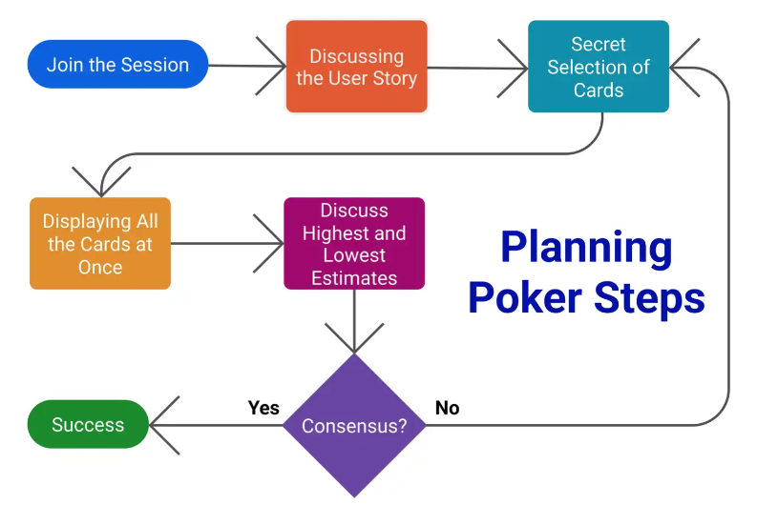
What is Planning Poker?
Planning Poker (also known as Scrum Poker) is an agile estimation technique used by Scrum teams to estimate the effort required for User Stories or tasks in terms of Story Points.
It is based on consensus-driven decision-making and uses the Fibonacci sequence (1, 2, 3, 5, 8, 13, …) for estimation. The goal is to reduce bias, encourage discussion, and improve accuracy in estimating work complexity.

Slide 18
Agile Estimation
Using Story Points for estimating complexity, effort, and risk allows Agile teams to focus on relative sizing, adapt to changes, and improve over time—without the constraints of exact time estimates. It's a key aspect of Agile flexibility and efficiency.
Story Points = Complexity + Effort + Risk
Not directly about time, but experience will help connect story points to rough timelines.
Keeps focus on value delivery and quality—not just deadlines.

Slide 19
What is Planning Poker?
How Planning Poker Works?
Preparation: Define the User Story 📋
  The Product Owner (PO) presents a User Story to the team.
  The team asks clarifying questions to understand complexity, dependencies, and risks.
Each Member Selects a Fibonacci Card 🃏
  Each team member privately selects a Fibonacci number representing their estimate.
  The number reflects the complexity & effort (not exact hours or days).
Reveal the Estimates 🎭
  Everyone simultaneously reveals their selected card.
  If all estimates are the same → ✅ Final estimate is accepted.
  If estimates differ → 🔄 Discussion begins!
Discuss & Align 💬
  Team members with high and low estimates explain their reasoning.
  After discussion, team votes again until a consensus is reached.
Final Story Point Assigned ✅
  The agreed-upon Story Point is assigned to the User Story.

Slide 20
Why is the Fibonacci Sequence Used in Agile Estimation (Planning Poker)?
In Agile Planning Poker, the Fibonacci sequence (1, 2, 3, 5, 8, 13, 21, …) is used for story point estimation because it reflects the increasing uncertainty of larger tasks.
Exponential Growth Reflects Uncertainty
  Small tasks (1, 2, 3) are easy to estimate accurately.
  Larger tasks (8, 13, 21) involve more uncertainty, making precise estimation difficult.
  The gap between numbers increases to account for the uncertainty.
Example: A task estimated at 2 points is easier to compare than one estimated at 13 points, which has much more variability.
Encourages Meaningful Discussions
  The larger the gap, the more important it is to discuss and justify estimates.
  If one developer selects 5 and another selects 13, they must discuss why their estimates differ.
This leads to better understanding and alignment among the team.

Slide 21
Why is the Fibonacci Sequence Used in Agile Estimation (Planning Poker)?
Prevents False Precision
  Traditional estimation methods use linear scales (4, 5, 6, 7...), which give a false sense of accuracy.
  Instead, Fibonacci forces teams to round up and think in broad terms.
  Example: If a task seems between 5 and 8, it’s probably closer to 8 due to additional complexities.
Speeds Up Decision-Making
  Since the differences between numbers are bigger, teams avoid unnecessary debates over minor differences.
  Instead of debating whether a task is a 6 or 7, teams choose between 5 or 8 and move forward.
  This makes Sprint Planning faster and more efficient.

Slide 22
Why Story Points Reflect Complexity & Effort (Not Exact Hours or Days) in Agile Estimation
In Agile, Story Points are used to estimate relative effort, complexity, and risk associated with a User Story. They do not directly represent exact hours or days. This approach is intentional and offers several advantages for planning and executing work effectively.
Traditional Time Estimation vs. Story Points
Aspect | Time-Based Estimation | Story Points
Unit of Measure | Hours or Days | Complexity, Effort, Risk
Focus | How long it takes | How hard it is to do
Precision | High (but often unrealistic) | Flexible & relative
Effect of Uncertainty | Often underestimated | Captures unknowns with bigger points
Example | "3 hours to fix this bug" | "This bug is a 5-point effort"

Slide 23
What Do Story Points Measure?
Complexity:
  How complicated is the work?
  Does it involve unknown technologies?
  Example: "Building a login feature with security measures" might be more complex than "changing the color of a button."
Effort:
  How much work is needed?
  Is it a straightforward task or a deep dive?
  Example: Adding a simple banner might be 1 point, while creating a recommendation engine might be 13 points.
Risk & Uncertainty:
  Are there unknowns that might make the task harder?
  Is there any potential for surprises (e.g., legacy code, third-party API limits)?
  Example: Implementing a third-party payment system might have hidden complexities → 8 points.

Slide 24
Why Not Use Exact Hours or Days?
Avoids False Precision
Estimating exact hours can give a false sense of accuracy, as software development is inherently unpredictable.
Agile recognizes that unforeseen complexities can arise, making precise time estimates unreliable.
Focuses on Relative Effort
Story Points focus on how one task compares to another.
Example:
  A task estimated at 5 Story Points is roughly twice as complex as a 2-Point task.
  This helps in planning and prioritization, rather than debating exact hours.
Simplifies Planning Across Teams
Different team members may work at different speeds. Story Points standardize effort estimation, allowing the team to focus on delivering value rather than time tracking.
Improves Estimation Accuracy Over Time
Teams track velocity (average Story Points completed per Sprint), helping them predict how much work they can take on in future Sprints.
With experience, Story Point estimates become more accurate as the team learns from past Sprints.

Slide 25
Example of Complexity vs. Time in Story Points
User Story | Complexity | Effort | Story Points
"As a user, I want to log in with email." | Low | Moderate | 2
"As a user, I want to reset my password." | Moderate | Moderate | 3
"As an admin, I want to monitor login attempts." | High | High | 8
"As a user, I want 2FA for login." | High | High | 13
Even if tasks take different actual times (e.g., 1 day or 3 days), Story Points capture the relative effort and complexity.
How Does Story Points Translate to Time?
While Story Points don't directly map to hours, the team's velocity (average Story Points completed in a Sprint) helps approximate time:
If a team completes 20 Story Points in a 2-week Sprint:
  1 Story Point ≈ 0.5 days (on average).
This approach balances the need for planning without getting bogged down in exact estimates.

Slide 26
Track work progress

Slide 27
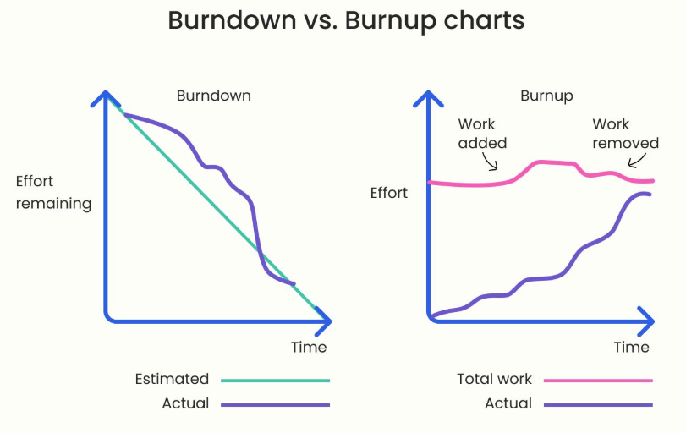
Burndown & Burnup Charts in Agile
Burndown and Burnup charts are visual tools used in Agile to track work progress and help teams understand if they are on track to complete their tasks within a Sprint or project timeline.
Use a Burndown Chart for Sprint-level tracking to monitor daily progress.
Use a Burnup Chart for project-level tracking, especially when scope changes frequently.
Feature | Burndown Chart | Burnup Chart
Tracks | Work remaining | Work completed
Trend Direction | Decreasing | Increasing
Scope Changes Visibility | ❌ Not visible | ✅ Clearly visible
Best For | Monitoring daily Sprint progress | Tracking overall project delivery

Slide 28
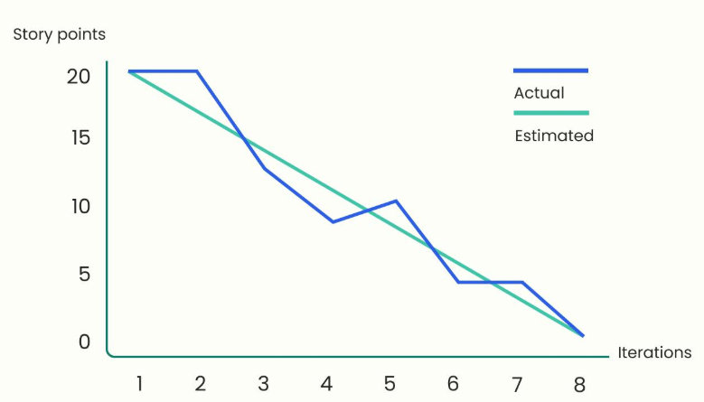
What is a Burndown Chart?
A Burndown Chart shows the remaining work decreasing over time until it reaches zero by the end of the Sprint or project.
Key Components of a Burndown Chart:
X-Axis (Time): Represents Sprint days or project timeline.
Y-Axis (Remaining Work): Measures Story Points, tasks, or hours.
Ideal Trend Line: A straight line showing expected work completion.
Actual Work Line: Shows real progress; can be above or below the ideal line.
Example of Burndown Chart Use Case:
Scenario: A Sprint starts with 50 Story Points. Each day, the team completes some work.
  If on track: The actual work line closely follows the ideal line.
  If behind schedule: The actual line remains above the ideal trend.
  If ahead of schedule: The actual line dips below the ideal trend.

Slide 29
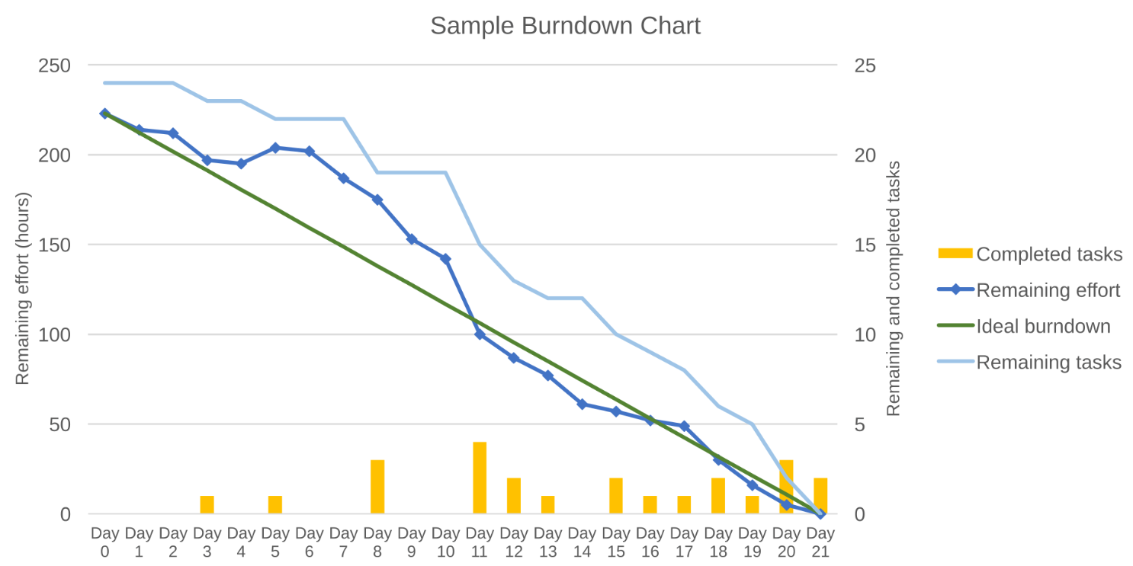
What is a Burndown Chart?
A sample burndown chart for a completed iteration. It shows the remaining effort and tasks for each of the 21 work days of the 1-month iteration.

Slide 30
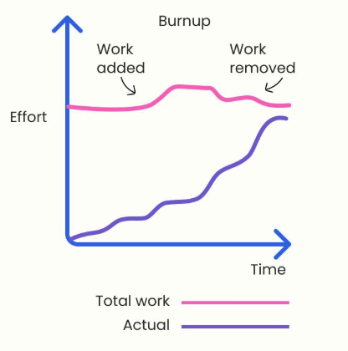
What is a Burnup Chart?
A Burnup Chart shows work completed over time, moving upwards until all tasks are done.
Key Components of a Burnup Chart:
X-Axis (Time): Represents Sprint days or project timeline.
Y-Axis (Work Done): Measures completed Story Points, tasks, or hours.
Total Scope Line: Represents the total work planned.
Completed Work Line: Shows progress as the team finishes work.
Example of Burnup Chart Use Case:
Scenario: A project has 100 Story Points to complete.
  If work progresses smoothly: The completed work line steadily moves upwards.
  If scope changes: The total scope line may move up (new tasks added) or down (scope reduced).

Slide 31
Thank you

